Slide 1

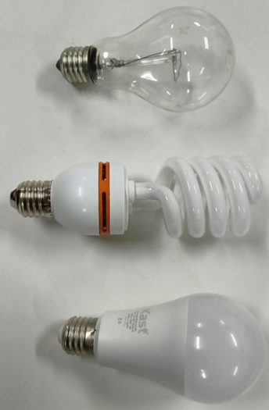

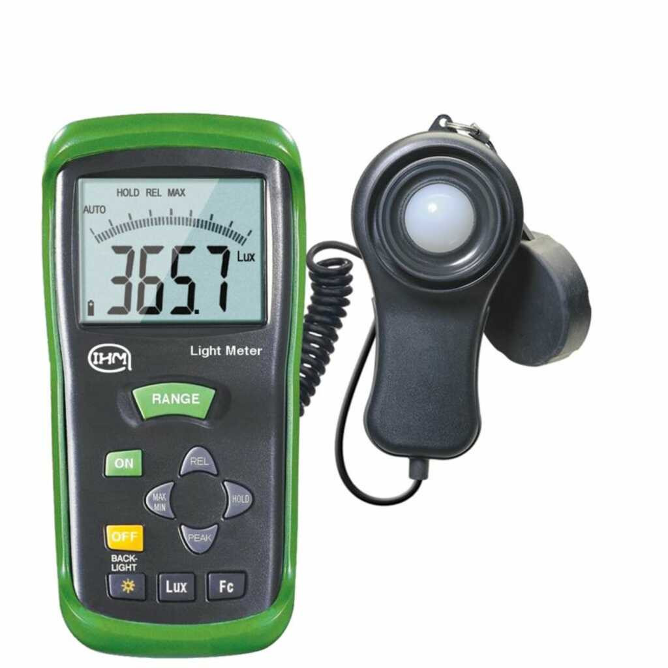
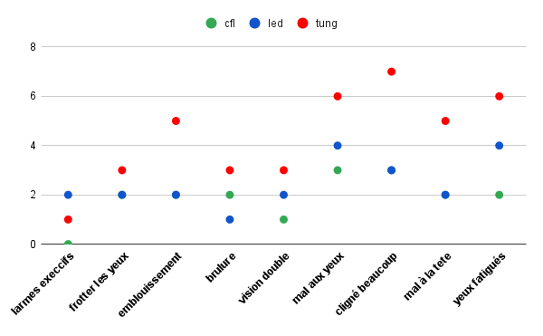
VISUAL FUNCTION, EYE STRAIN, AND DRY EYE SYMPTOMS IN PRESBYOPES: THE IMPACT OF LIGHTING DURING SUSTAINED READING
Kheira-Kefif*¹, Radja-Khatir², Yacine-Chibane¹, Imene-Telli¹, Aicha-Kefif³, Kouider-Driss-Khodja¹, Bouhalouane-Amrani¹
¹Address: Laboratory of Theory and Simulation of Materials, Faculty of Exact and Applied Sciences, University of Oran1 Ahmed Ben Bella, Oran, Algeria.
²Address: 2Laboratory of Electrical Engineering and Materials, Higher School of Electrical and Energy Engineering, Oran, Algeria.
³Address: Optometrist, TAM-Optique, Tamanrasset, Algeria.
ABSTRACT
INTRODUCTION
Purpose: This study aims to evaluate the impact of various artificial lighting sources on visual performance, ocular fatigue, and dry eye symptoms in presbyopic subjects during sustained near-vision tasks.
Methods: A group of presbyopic participants was recruited to perform a prolonged reading task under three different light sources: compact fluorescent light (CFL), light-emitting diode (LED), and tungsten (TUNG). To ensure consistency, the illumination level was maintained at a constant 400 lux for all conditions. Several clinical parameters were assessed before and after the tasks, including near and distance visual acuity (VA), objective refraction, and ocular surface stability (dry eye assessment). Additionally, participants’ subjective visual comfort and asthenopic symptoms were recorded using standardized indicators.
Reading is a visual activity that requires good lighting quality to be comfortable and effective, so it is important to understand how lighting conditions can affect our visual comfort and overall reading experience.
Lampes | Caractéristiques
CFL: tube containing argon and a small amount of mercury vapor. It generates invisible ultraviolet light. The invisible light excites a fluorescent coating inside the tube, which then emits visible light. | Température : 4000K Puissance : 26W Flux lumineux : 1560 lumen
LED: It operates on the principle of electroluminescence. When a current passes through the diode, minority charge carriers and majority charge carriers recombine at the junction. During recombination, energy is released in the form of photons. | Température : 6500k Puissance : 15 W Flux lumineux : 1500 lumen
TUNGSTEN: functions like thermal radiators. The light is generated by heating a solid body to a very high temperature. | Température : 2700 k Puissance : 200W Flux lumineux : 2600 lumen
To measure illumination, we should use a luxmeter.
RESULTS
We position the patient 40 cm from the reading plane and start the timer for 45 minutes.
The findings revealed significant variations across the three lighting conditions. Under CFL, both near and distance visual acuity remained stable for all participants. However, a noticeable decline in VA was observed under LED and tungsten lighting. Refractive stability was best maintained under CFL (remaining near baseline), whereas a refractive shift was detected during sustained reading under LED and tungsten. Interestingly, while the subjective evaluation indicated a clear preference for CFL regarding overall visual comfort, prolonged exposure to LED lighting resulted in acceptable performance but was associated with increased symptoms of ocular fatigue over time. Conversely, reading under tungsten lighting was rated poorly from the outset, characterized by significant visual discomfort and high levels of eye strain.
The CFL lamp has a less harmful impact on distant visual acuity for both genders.
Symptoms of eye fatigue are nearly negligible under CFL lighting
Distance visual acuity in men
Distance visual acuity in women
LED
CFL
LED
CFL
LED
TUNG
CFL
LED
TUNG
CFL
LED
TUNG
CFL
LED
TUNG
TUNG
TUNG
VA 10/10
Visual Acuity below 10/10
VA 10/10
Visual Acuity below 10/10
The CFL lamp has a less harmful impact on near visual acuity for both genders
Near visual acuity in men
Near visual acuity in women
All participants prefer the CFL lamp over the other lamps.
CFL
CFL
Comfortable
Good
CFL
TUNG
CFL
CFL
TUNG
TUNG
TUNG
LED
LED
VA P2
TUNG
LED
LED
VA P2
Near visual acuity below P2
CFL lighting appears to provide a better sense of comfort for both men and women.
Comfort perception distribution among women.
Comfort perception distribution among men.
CFL
LED
TUNG
CFL
LED
TUNG
CFL
LED
TUNG
Conclusion: This study demonstrates that the choice of light source significantly influences visual comfort and performance in presbyopes during extended reading. CFL was identified as the most comfortable source, providing the best refractive stability and lowest symptom scores. While LED is functionally acceptable, its long-term use may trigger advanced fatigue symptoms. Tungsten lighting appears unsuitable for sustained near-tasks due to high visual discomfort. These results highlight the importance of ergonomic lighting design to mitigate ocular dryness and strain in the aging eye.

